Slide 1
BRINGING ETHEREUM TO THE ENTERPRISE
Building a HashiCorp Vault Plugin for Ethereum
jeff ploughman
jeff@immutability.io
Notes:
Hello, I’m Jeff
Welcome to the 2nd meetup of the DC-Balitmore Hashicorp User Group.
Today, we are going to talk about secrets – and not in hushed tones. We will talk about Hashicorp Vault and it’s new plugin architecture. We will talk a *little* about Ethereum. And, I will share with you the results of some experiments that I have done.
The bulk of this presentation is a live demo rather than just PowerPoint - I suck at PowerPoint. I will be installing most of the tools I will use for the demo from scratch, so there should be a little tight-rope tension to the talk. My hope is that everything I do here can be done on your own machine.
I will pause briefly after the Ethereum overview for questions. I will pause briefly after the Vault overview for questions.

Slide 2


+
Notes:
Today we are going to discuss the mechanics and motivations for using HashiCorp Vault as an Ethereum wallet.
If you haven’t heard of HashiCorp Vault, it is the premier OSS secrets management solution for enterprises. My day job involves automating the provisioning of Vault policies and secrets and integrating Vault into DevOps workflows.
If you haven’t heard of Ethereum, it is the most innovative ecosystem in the blockchain world. I will give a brief overview in a moment.

Slide 3
MOTIVATION
learn through experimentation
Notes:
Before I talk about the mechanics of Vault or give an overview of Ethereum, I’d like to talk briefly about why I did this.
The first motivation is probably something you all can relate to: the best way to learn a new technology is to build something useful – to experiment. Since I use Vault a lot, I needed to learn the new plugin architecture; since I am passionate about Ethereum, I wanted to get closer to the mechanics of its client.

Slide 4
MOTIVATION
learn through experimentation
build better tools
Notes:
I attended DevCon3 last November and was quite intrigued by a recurrent theme in most presentations. Seemed that each team lamented the lack of development tools in the ecosystem and made mention that their first order of business after ICO funding was to build their own development environments from the ground up.

Slide 5
MOTIVATION
learn through experimentation
build better tools
bridge ecosystems to enable innovation
Notes:
The Ethereum ecosystem is based on decentralization – where infrastructure means a laptop. I believe that the immutable architecture community has a maturity and wealth of techniques that could bring much innovation to Ethereum.

Slide 6
MOTIVATION
learn through experimentation
build better tools
bridge ecosystems to enable innovation
solve a specific use case
Notes:
Also, I wanted to solve a specific use case… securely: more about that later.

Slide 7
ETHEREUM OVERVIEW
what is ethereum?
ethereum is a network and a computer
ethereum has a blockchain
ethereum has a built-in cryptocurrency: ether (ETH)
ethereum uses proof-of-work
ethereum is public, permissionless, and serverless
ethereum is decentralized
Notes:
what is ethereum
ethereum is software running on a network of computers that ensures that data and small computer programs called smart contracts are replicated and processed on all the computers on the network, without a central coordinator. the vision is to create an unstoppable censorship-resistant self-sustaining decentralised world computer.
It does that using a blockchain and a cryptocurrency. Cryptocurrency is not an end in itself in the Ethereum ecosystem – it is a means to create rewards to operate the network/computer and it is a security mechanism. Every transaction you send has a cost – this prevents spamming of the network.
Ethereum currently uses proof-of-work as the consensus mechanism – this is called Nakamoto consensus. Nakamoto consensus doesn’t require any trusted parties or pre-assumed identities among the participants. PoW is extremely consumptive of energy. Ethereum will move to PoS at some time in the next 2 years.

Slide 8
ETHEREUM CONCEPTS
accounts
smart contracts
gas and gas price
clients/nodes
transactions
miners
Notes:
In this demo, we will touch on a few core Ethereum concepts. The most important of which is an account - in bitcoin, there is a concept called address where bitcoins are stored – like a bank account number. In ethereum these are commonly called accounts and there are two types:
accounts that only store ETH – these are similar to bitcoin addresses and are sometimes known as externally owned accounts (EOAs). you make payments from these accounts by signing transactions with the appropriate private key
smart contracts are accounts that store ETH and have code that can be run
These smart contracts are little computer programs that are stored on ethereum’s blockchain. they can be activated, or run, by funding them with some ETH.
When you activate a smart contract, you ask all the miners in the whole network to each individually perform the calculations within it. this costs them time and energy, and gas is the mechanism by which you pay them for that service.
Ethereum is a network of nodes or clients. In this presentation I will use the go-ethereum client – geth. Nodes can be light or full – terms that describe the amount of blockchain data present on the node. Nodes can be read-only or nodes can be miners.
You interact with the Ethereum ecosystem by sending transactions - transactions to send ETH to other EOAs, transactions to deploy smart contracts, transactions to execute code. The way transactions get applied to the ledger – the blockchain – is by mining.

Slide 9
ETHEREUM QUESTIONS?

Slide 10
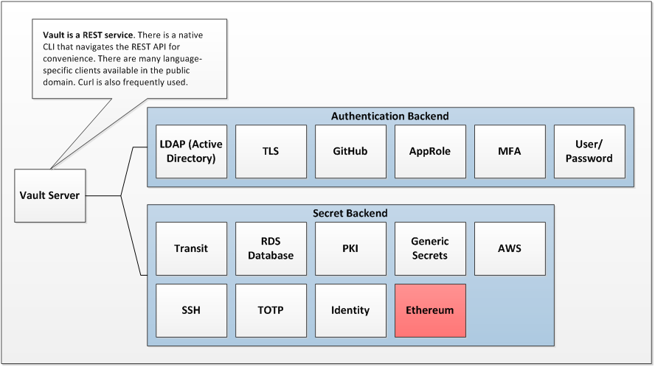
VAULT OVERVIEW
Notes:
vault is a tool for securely accessing secrets. a secret is anything that you want to tightly control access to, such as api keys, passwords, certificates, etc. In our scenario, the private key associated with an Ethereum account is a secret - so is its passphrase. Vault also maintains detailed and secure audit log.
Vault is best seen as a broker between authentication backends and secret backends – many authentication methods are supported and many kinds of secrets. Every authenticated identity is attached to a policy that governs access to secrets.

Slide 11
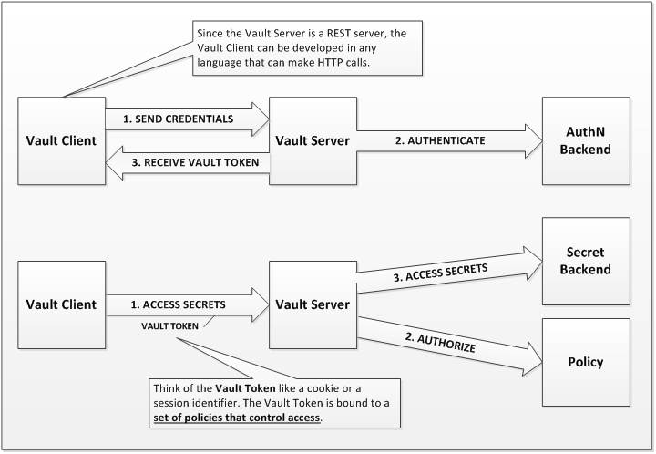
VAULT AUTHENTICATION
Notes:
There is a ceremony to using vault that mirrors the model for most permissioned websites:
You authenticate to one of many AuthN backends
You receive a session token that is used for subsequent access to Vault.
This session token is attached to a set of polices that Vault uses to authorize access to secrets
You access secrets

Slide 12
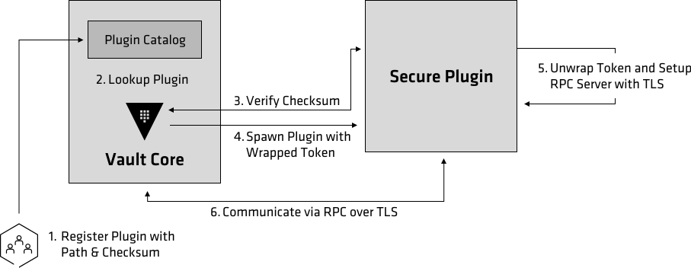
VAULT PLUGINS
Notes:
Recently, HashiCorp documented their plugin architecture and allowed developers to build their own backend plugins – secrets, authentication or audit.
A plugin is Golang code that you compile into a single file executable. A vault administrator registers a plugin with Vault by adding it and a sha256 sum to a catalog.
When vault wants to run a plugin, it first looks up the plugin, by name, in the catalog. it then checks the executable's sha256 sum against the one configured in the plugin catalog.
finally vault runs the command configured in the catalog.

Slide 13

THE USE CASE
Notes:
I mentioned earlier that a particular use case was motivation for this experiment. Let me try to describe the problem:
Ethereum is decentralized. That is great. However, there is a bit of ideological fervor … zeolotry? to the commitment to decentralization:
The attitude at times seems like:
I just need my laptop… that’s all I need…. we don't need any of that centralized infrastructure... we don't need any servers... well maybe a well-known bootnode...
but then a scaling issue occurs (kittens?) and some benefactor (Infura) runs a bunch of read only nodes to satiate demand.
the fact is, when you work in any sort of collaborative environment, there are reasons why you might want to manage infrastructure beyond a single laptop. As soon as you want to do enterprise scale software development, even decentralization zealots will start to realize that they need more… and more.

Slide 14
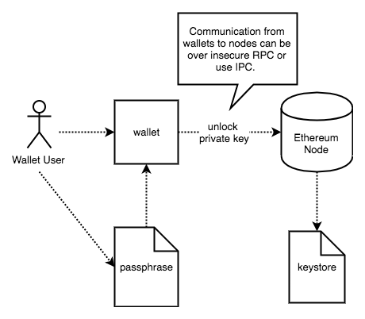
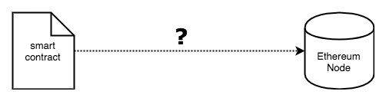
THE USE CASE
Notes:
Here is the use case:
RPC communication to Ethereum nodes is not over TLS – just straight up HTTP. This means that running a node anywhere other than you laptop, is a problem: because the keystores live, encrypted, on a node and the passphrase to decrypt them lives elsewhere.
The "official" guidance is to use IPC as a communication mechanism between wallets and nodes, but, this isn’t awesome because your wallet has to live on the same machine as the client - scalability be damned.
Furthermore, what about CI/CD and smart contracts? A shared pipeline is a critical enabler of development at scale. How would that work? Even if you run a node on your build slave, you have the problem of how to get the passphrase to that node.

Slide 15
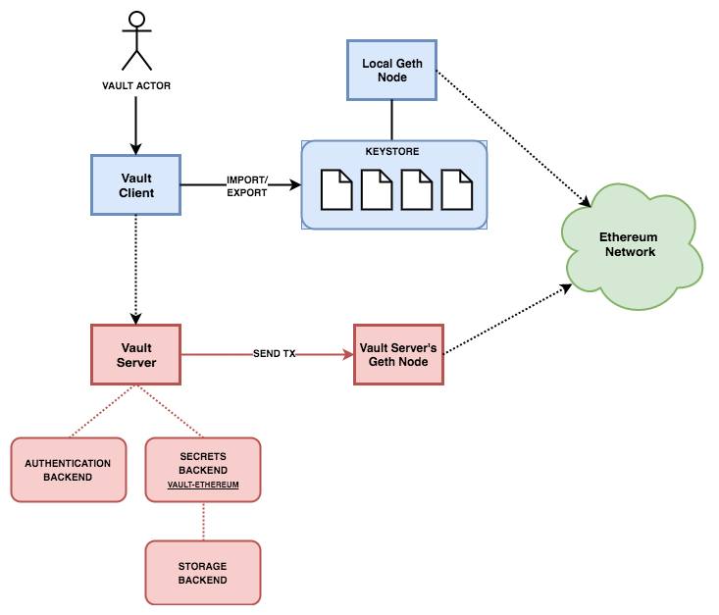
VAULT ETHEREUM PLUGIN
Notes:
Finally, we are to my plugin – the vault ethereum plugin.
the vault ethereum plugin is intended to provide many of the capabilities of an ethereum wallet within the context of the enterprise. it is designed to support smart contract CI/CD practices. none of the functionality requires a local ethereum node to be running.
It uses vault to store the private keys AND passphrases for your ethereum accounts. You authenticate to vault using any desired mechanism (including MFA – demoed.) You then sign and send transactions from vault without the private keys or passphrases ever leaving the secure boundary of vault
Passphrases are available at a specific path that can be protected with additional policies.

Slide 16
VAULT QUESTIONS?

Slide 17
DEMO TIME

Slide 18
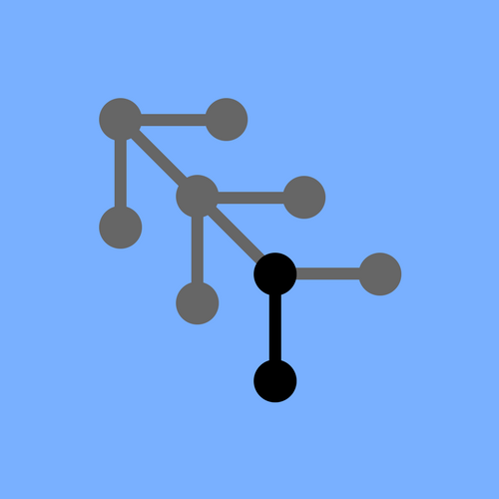
PREREQUISITES
Notes:
The prerequisites for this demo are simple: You need Docker to run the Ethereum client; and, you need Keybase to encrypt your vault keys.

Slide 19
INSTALL HashiCorp Vault AND ETHEREUM PLUGIN
Notes:
Run ./install.sh
This will create a self signed certificate, download vault and the vault ethereum plugin, check their SHA256SUMS, install vault and the plugin, start vault, and unseal it. The unseal keys and the root token are encrypted with your Keybase PGP key and saved as files on the file system.
Run ./github.sh
This will enable authentication against the github backend and create a role for me in my GH organization.

Slide 20
ADD MFA
$ export VAULT_TOKEN=$(keybase decrypt -i $KEYBASE_USER"_VAULT_TOKEN.txt")
$ vault policy-write ethereum_root ethereum_root.hcl
$ vault auth-enable github
$ vault write auth/github/config organization=$GITHUB_ORG max_ttl="1h" ttl="1h”
$ vault write auth/github/map/users/$GITHUB_USER value=ethereum_root
$ vault write auth/github/mfa_config type=duo
$ vault write auth/github/duo/access \
host=$DUO_API_HOSTNAME \
ikey=$DUO_INTEGRATION_KEY \
skey=$DUO_SECRET_KEY
$ vault write auth/github/duo/config \
user_agent="" \
username_format="%s-ethereum”
$ unset VAULT_TOKEN
Notes:
So, now we are going to add MFA to our Ethereum wallet. How many of you using MetaMask or Mist have that?
DUO has a free service that gives MFA capability to up to 10 users and it is supported by HashiCorp Vault.
This is the first inkling of the ecosystem bridge that I was talking about afforded to the Ethereum community by the HashiCorp community.
I have already enrolled myself and my device with DUO. I will attempt to enroll a brand new GitHub user here now. This user has to be a member of the GitHub organization.
./github_user.sh cipher-punk cypherhat

Slide 21
ENROLL DEVICE
$ export VAULT_AUTH_GITHUB_TOKEN=…
$ vault auth -method=github
Error making API request.
URL: PUT https://localhost:8200/v1/auth/github/login
Code: 400. Errors:
* Enroll an authentication device to proceed
(https://api-79cd4b94.duosecurity.com/portal?code=b3a236d5305b281d&akey=DAD7U2QRME0F43UFPT20)
$ vault auth -method=github
Successfully authenticated! You are now logged in.
The token below is already saved in the session. You do not
need to "vault auth" again with the token.
token: 48b49ccf-f6d3-de60-0a53-3f583fcd823c
token_duration: 3599
token_policies: [default ethereum_root]
Notes:
Now we authenticate to Vault. Since our user hasn’t been enrolled in MFA, this will fail. So, we go to the DUO site (with the URL supplied) and we enroll the device.
After enrollment, we authenticate again. Assuming that all worked according to plan, our phone will chirp, and we will confirm.

Slide 22
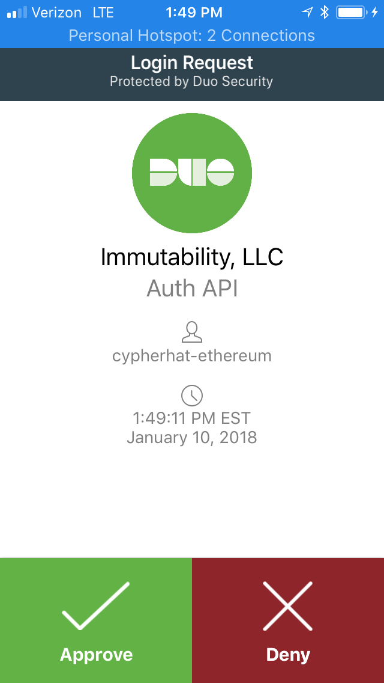
AUTHENTICATE

Slide 23

INSTALL ETHEREUM
Notes:
Now we will install Ethereum. It must be said, that for the purpose of this demo, I have already installed Ethereum – as a private chain - and run it the first time. I did this because it takes a little while (~30-45 minutes) to create the initial DAG used as a foundational data structure for Ethereum's PoW mechanism. I have wiped everything and reinstalled enough times to be confident that your mileage should not vary if you try to do this at home. Nevertheless, I will walk through the installation steps as if this was a virgin install.
So, first we pull the docker images. I have a script that does this - named pull_images.sh curiously enough.
I am running portainer – this is totally not necessary. But, I use it because it saves some typing and lets me get a big picture of my docker environment.
The first thing we have to do is start a bootnode. The bootnode, addressable by a URL, is how the Ethereum clients will discover each other.
./bootnode.sh
./getbootnodeurl.sh – to see the URL
Now we start our first Ethereum client – this will be a read only client. I will name it `ethereum-wallet`. I will start it listening on port 8545:
RPC_PORT=8545 ./runnode.sh wallet
And lastly, we will start mining Ethereum – in order to commit transactions as well as to have some ETH to play with. But, before we do that, I want to create an Ethereum account (an EOA) that we will send the mined ETH into.
How will we create such an account? Hmm…

Slide 24
MINE INTO ACCOUNT
$ RPC_PORT=8546 ETHERBASE=$(vault write -format=json ethereum/accounts/etherbase chain_id=1977 generate_passphrase=true | jq .data.account | tr -d '"') ./runminer.sh etherbase
Destroying old container ethereum-etherbase...
ethereum-etherbase
ethereum-etherbase
Starting ethereum-etherbase
4174b66b3001adb12307958d54def6b493077eab0eb48f4b8018e966a82c083f
Notes:
We will use our Vault Ethereum plugin of course! And, we will do it in one line.
RPC_PORT=8546 ETHERBASE=$(vault write -format=json ethereum/accounts/etherbase chain_id=1977 generate_passphrase=true | jq .data.account | tr -d '"') ./runminer.sh etherbase

Slide 25
GET ACCOUNT BALANCE
$ vault read ethereum/accounts/etherbase
Key Value
--- -----
address 0xa2d0566A6DCb1Eb7687F40E373ed7d53af44dD05
chain_id 1977
pending_balance 95000000000000000000
pending_nonce 0
pending_tx_count 0
rpc_url http://localhost:8545
Notes:
Let’s check the balance. It should read 0 initially, but then quickly start to increase.

Slide 26
IMPORT EOA
$ read -s PASSPHRASE; vault write ethereum/import/oldwallet path=/Users/immutability/.ethereum/keystore/UTC--2017-12-01T23-13-37.315592353Z--a152e7a09267bcff6c33388caab403b76b889939 passphrase=$PASSPHRASE; unset PASSPHRASE
Key Value
--- -----
path /Users/immutability/.ethereum/keystore/UTC--2017-12-01T23-13-37.315592353Z--a152e7a09267bcff6c33388caab403b76b889939
Notes:
Now, as I mentioned, I had already installed Ethereum locally. I have been mining into an account for about a day to create some funds to use in this demo. I could have run an Ethereum faucet, but I prefer the development environment to mirror the production environment as much as possible.
The use case I am trying to simulate is: imagine that you have never used this wonderful Ethereum Vault plugin, but you have been convinced of its awesomeness, so you want to bring existing accounts in. This is simple: you import a JSON keystore. All you need is the passphrase used to encrypt the keystore and the keystore file. Keystore files (for geth) are located in ~/.ethereum/keystore
$ vault write ethereum/import/oldwallet path=/Users/immutability/.ethereum/keystore/UTC--2018-01-15T15-20-58.882677940Z--204baf5cbad527c918e4f7ead9bf88051bdca38a passphrase=$(cat /keybase/private/cypherhat/ethereum_test/demo.key) chain_id=1977
$ vault read ethereum/accounts/oldwallet

Slide 27
EXPORT EOA
$ vault write ethereum/accounts/etherbase/export directory=.
Key Value
--- -----
path /Users/immutability/.ethereum/keystore/UTC--2017-12-01T23-13-37.315592353Z--a152e7a09267bcff6c33388caab403b76b88993
$ vault read ethereum/accounts/etherbase/passphrase
Key Value
--- -----
passphrase chute-nylon-yanking-overtly-ipod-sheath-register-ounce
Notes:
And while the Vault Ethereum wallet is awesome, it doesn’t have a UI. So, if you want to move your account into another wallet this is pretty easy too. You export the account into a directory - the keystore file is returned. You will also need the passphrase for this keystore.
Let’s open up MetaMask to demonstrate.

Slide 28
SEND ETH
$ vault write ethereum/accounts/oldwallet/debit to=0x0374E76DA2f0bE85a9FdC6763864c1087e6Ed28b value=10000000000000000000
Key Value
--- -----
tx_hash 0xe99f3de1dfbae82121a009b9d3a2a60174f2904721ec114a8fc5454a96e62ba8
Notes:
So, we have created Ethereum accounts and moved them gracefully between Vault and wallets. Let’s now move some ETH! Sending ETH is simple – we debit the account. We need an account address to send the ETH to and the value (in Wei.) The gas amount and price are defaulted. In a production environment you would not use these defaults! I will be adding code for better gas/gas price estimation.
The result is the transaction hash which can be seen in the logs and the blockchain. Since the account that is credited is in my MetaMask wallet, we can go there to see that the ETH was indeed transferred.

Slide 29
BUILD CONTRACT
$ dapp build
+ dapp clean
+ rm -rf out
+ solc --overwrite ds-test/=lib/ds-test/src/ ds-test=lib/ds-test/src/index.sol --abi --bin --bin-runtime = -o out/ src/Helloworld.sol
+ solc --overwrite ds-test/=lib/ds-test/src/ ds-test=lib/ds-test/src/index.sol --combined-json=abi,bin,bin-runtime,srcmap,srcmap-runtime,ast = src/Helloworld.sol
+ solc --overwrite ds-test/=lib/ds-test/src/ ds-test=lib/ds-test/src/index.sol --abi --bin --bin-runtime = -o out/ src/Helloworld.t.sol
+ solc --overwrite ds-test/=lib/ds-test/src/ ds-test=lib/ds-test/src/index.sol --combined-json=abi,bin,bin-runtime,srcmap,srcmap-runtime,ast = src/Helloworld.t.sol
dapphub tools
Notes:
The last order of business is to deploy an Ethereum smart contract. I am not going to get into the Solidity development environment at all except to say that I am liking the tools from the MakerDAO guys – Dapphub tools. This is a nix-based environment that is very friendly if you are used to Unix development. I have a very simple contract – a Helloworld contract – that I will build. This produces a couple of things:
The ABI file – which is a JSON description of the Contract’s interface; and,
The bin file – which is the EVM byte code. It is the EVM byte code that we deploy.

Slide 30
DEPLOY CONTRACT
$ vault write ethereum/accounts/oldwallet/contracts/helloworld transaction_data=@Helloworld.bin value=10000000000000000000 gas_price=21000000000 gas_limit=1500000
Key Value
--- -----
account_address 0x206d4B8aB00F1D3FdD3683A318776942f82A7F28
pending_balance 200779500000000000000
pending_nonce 7
pending_tx_count 0
tx_hash 0x206ba52b1edd32510e6ab607bbfbba70369595210d22885b3067868a376e9677
Notes:
To deploy a contract, we have to fund the contract and pay for deployment. Let’s use the account we just imported. When we deploy the contract we provide values for the ETH that will fund the contract and the gas that will pay for the transaction.

Slide 31
CONTRACT ADDRESS
$ vault read ethereum/accounts/oldwallet/contracts/helloworld
Key Value
--- -----
contract_address 0x9dC730499BbAe80F4241a2523C516919C69339Af
tx_hash 0x206ba52b1edd32510e6ab607bbfbba70369595210d22885b3067868a376e9677
Notes:
The transaction doesn’t get committed immediately, so we won’t know the contract_address immediately. We will have to poll the Ethereum network for the address – the vault read command on the contract path does this.

Slide 32
WARM/COLD STORAGE
# Kill Vault and copy to removeable media
$ kill -2 $(ps aux | grep '/usr/local/bin/vault server' | awk '{print $2}')
$ mv -f $HOME/etc $WARM_STORAGE/etc
$ mv "$KEYBASE_USER"_* $WARM_STORAGE
# Restore from removeable media
$ mv -f $WARM_STORAGE/etc $HOME/etc
$ nohup /usr/local/bin/vault server -config $HOME/etc/vault.d/vault.hcl &> /dev/null &
$ mv $WARM_STORAGE/"$KEYBASE_USER"_* .
$ vault unseal $(keybase decrypt -i $KEYBASE_USER"_UNSEAL_1.txt")
$ vault unseal $(keybase decrypt -i $KEYBASE_USER"_UNSEAL_2.txt")
$ vault unseal $(keybase decrypt -i $KEYBASE_USER"_UNSEAL_3.txt")
Notes:
Now, the best way to make sure that your ETH remains your ETH is to take your wallet offline. We do this by killing the vault process and copying the data to a flash drive. We also copy the PGP encrypted keys to a flash drive. Obviously, this needn’t be the same flash drive, but this is just a demonstration on how you can take your wallet offline and then restore simply and securely. Note: We are once again leveraging Keybase to secure our Vault keys.
To go cold (more like warm) we run the warm script:
./warm.sh cypherhat ~/cold
We verify that vault is indeed offline:
vault read ethereum/accounts/oldwallet
And to go back online, we run the hot script:
./hot.sh cypherhat ~/cold

Slide 33
WHAT’S NEXT?
container orchestration
concourse pipeline
oracle reference implementation
smart contract test harness
vault plugins for other cryptocurrencies?
vault plugins for exchanges?
Notes:
That’s about it. As you can see, there was a lot here; but, there is much more needed to fulfill the motivation of building modern DevOps practices into the Ethereum ecosystem. So I will leave you with a list of items that I will be focusing on. I hope that you will help me.
Cheers!

Slide 34
THANK YOU!
i hope this talk proved interesting and useful. more so, i hope that it inspires you to build oss tools for the ethereum ecosystem and participate in the oss community. please feel free to connect with me via linked in: https://www.linkedin.com/in/immutability/

Slide 35
Immutability's GitHub
Immutability's Docker Hub
HashiCorp Vault
Ethereum's Go Client
DC-Baltimore HashiCorp User Group

Slide 36
AND REMEMBER…
don’t lose your wallet
Notes:
Now, the best way to make sure that your ETH remains your ETH is to take your wallet offline. We do this by killing the vault process and copying the data to a flash drive. We also copy the PGP encrypted keys to a flash drive. Obviously, this needn’t be the same flash drive, but this is just a demonstration on how you can take your wallet offline and then restore simply and securely. Note: We are once again leveraging Keybase to secure our Vault keys.
To go cold (more like warm) we run the warm script:
./warm.sh cypherhat ~/cold
We verify that vault is indeed offline:
vault read ethereum/accounts/oldwallet
And to go back online, we run the hot script:
./hot.sh cypherhat ~/cold

